Slide 1
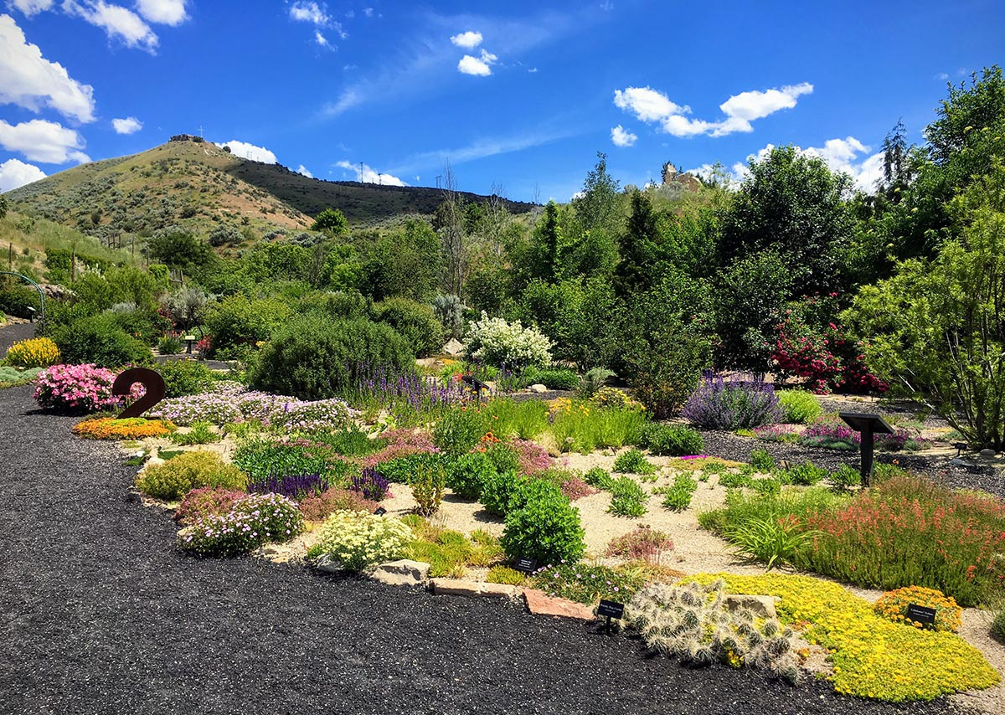
Firewise Plants
Salt Lake County
Notes:
Photo Credit:https://plantselect.org/fire-resistant-landscaping/

Slide 2

What is a firewise plant?
A species that has one or more characteristics that makes them ignite slower, less flammable, and burn less intensely than others.
*No plant is fireproof
Notes:
While no plant is entirely fireproof, selecting firewise plants can significantly mitigate the risk and spread of wildfires around your home. The benefits include:
- Slowing the spread of fire
- Reducing fire intensity
- Protecting structures
- Enhancing defensible space

Slide 3
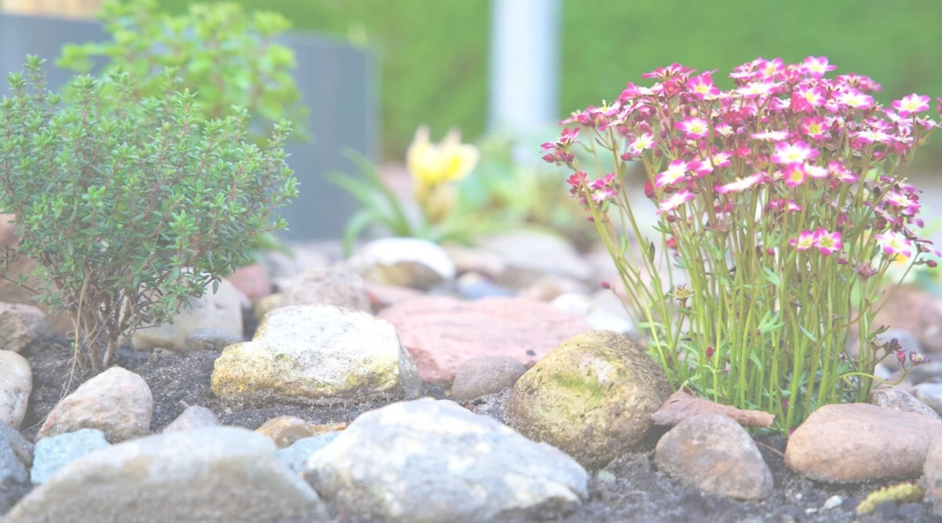
What Characterstics to look for?
Plant Tissues that contain more moisture, especially during fire season.
Notes:
*Dense plant tissues are a key characteristic to look for when assessing fire resistance. Plants with compact, tightly-packed cellular structures store significantly more moisture within their tissues. This higher moisture content acts as a natural fire barrier, making these plants slower to ignite and less likely to sustain flames during fire season.
*Deep root systems are a crucial characteristic of fire-resistant plants. Plants with roots that extend far into the soil can access groundwater reserves during dry seasons when surface moisture is depleted. This deep water access helps maintain plant moisture levels, making them less susceptible to ignition during fire season.
*The texture and thickness of leaves reveal a plant's moisture retention capacity. Succulent, fleshy leaves store water internally, making them more fire-resistant. In contrast, papery or thin leaves dry out quickly and become highly flammable during fire season. Look for plants with thick, waxy leaves that feel plump to the touch.
*Seasonal growth patterns-new growth on plants contains significantly higher moisture levels than mature vegetation. During spring and early summer, fresh shoots and leaves are more succulent and fire-resistant.
Photo Credit: https://www.epicgardening.com/firewise-landscape-design/

Slide 4
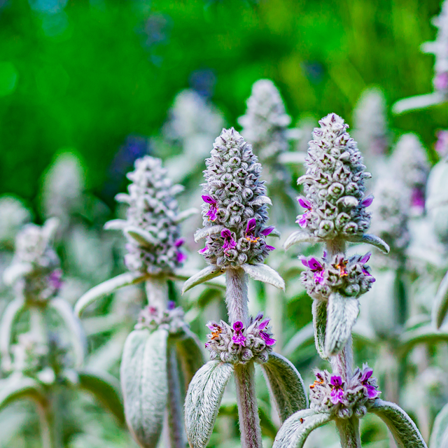
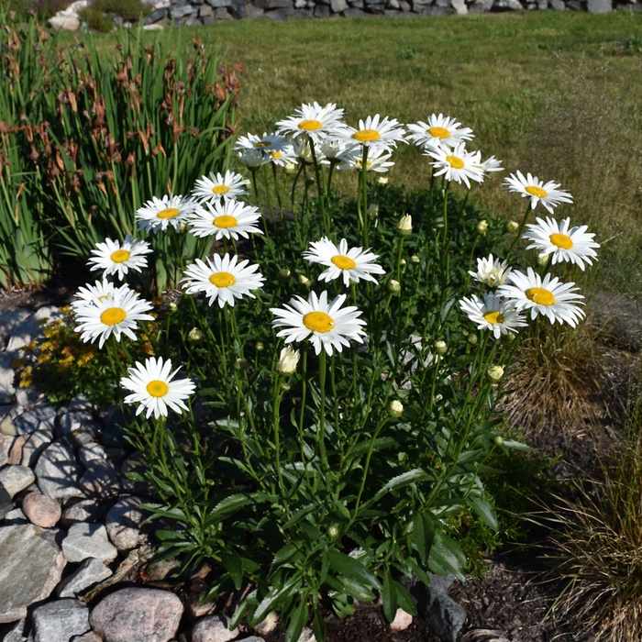
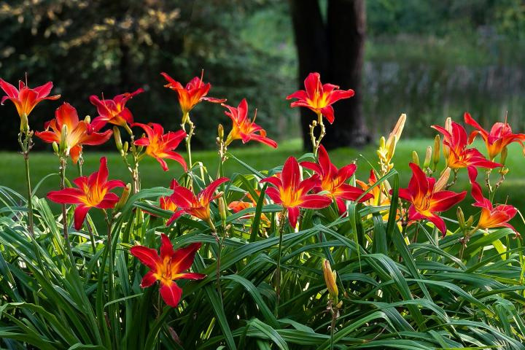
Examples of plants with more moisture
Shasta daisy (Leucanthemum x superbum
Daylily (Hemerocallis species)
Lamb’s Ear
(Stachys byzantina)
Notes:
*Some of the examples are not native
Shasta Daisy- not native. Their leaves and stems store plenty of water requiring more heat to evaporate that moisture before the plant can catch fire.
Daylily- not native. They have thick, fleshy, grass-like foliage retain high levels of moisture making them more resistant to catch fire.
Lamb's Ear- not native. Their velvety foliage has a high moisture content and lacks the volatile oils or resins that typically help fuel wildfires.

Slide 5

What Characterstics to look for?
Tissues that contain low amounts of volatile oils and other readily flammable chemicals.
Notes:
Low amounts of volatile oils and other flammable chemicals are a low flammability species.
Benefits include:
-Less likely to ignite (fewer combustible compounds). Ex. terpenes, waxes, fats, oils or resins.
-Slower to catch fire when exposed to heat or embers.
-Less intense when burning because it produces smaller flames and less heat.

Slide 6
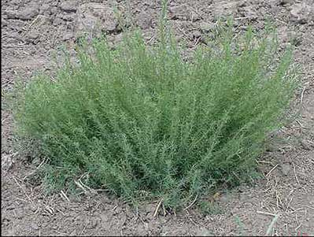
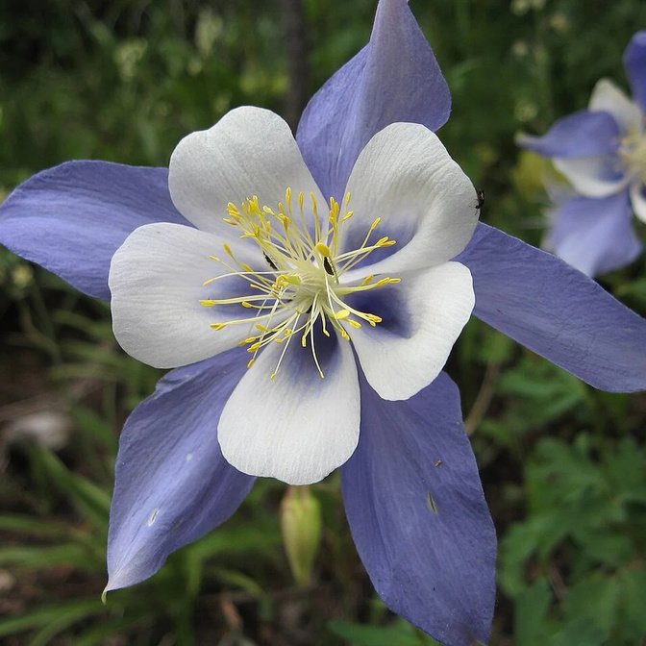
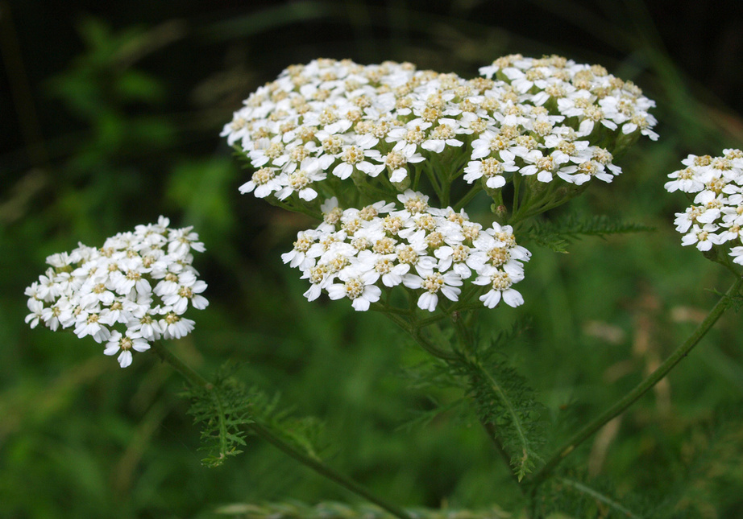
Examples of plants with low volitile oils
Immigrant Forage Kochia
(Kochia prostrata)
Rocky Mountain Columbine
(Aquilegia coerulea)
Common Yarrow
(Achillea millefolium)
Notes:
Immigrant Forage Kochia - non native. Lacks volatile oils making it easier to resist ignition.
Rocky Mountain Columbine- Native. Has very low levels of terpenes, sap, or oils
Common Yarrow- Native. Has low levels of volatile oils making the plant harder to ignite.

Slide 7
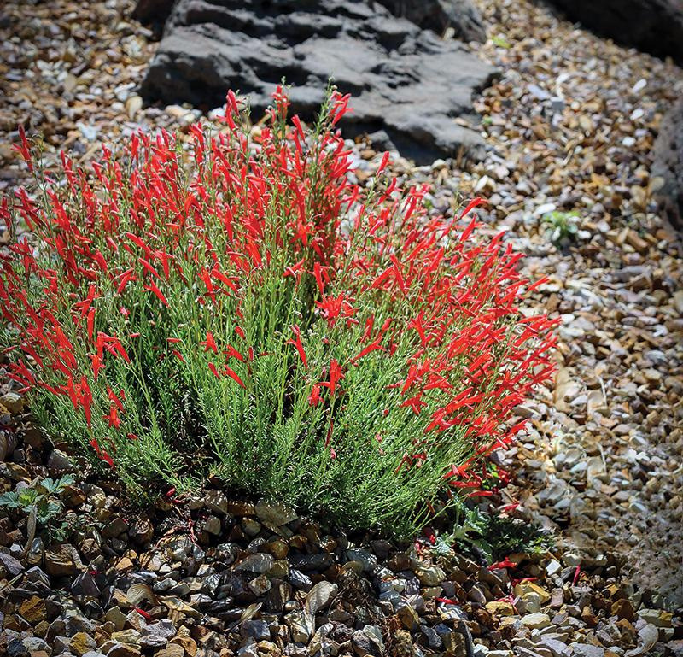
What Characterstics to look for?
Plants that provide less fuel, either by producing less litter or by staying small.
Notes:
Low litter production- select plants that do not drop large amounts of seasonal leaves, bark or branches. Flammable materials on the ground act as ladder fuels that allow surface fires to spread to taller vegetation and structures.
Avoid plants with tight dense, dense twiggy structures that trap dry leaves and dead needles within their canopies
*Example Penstemon species (pictured)
Photo Credit:https://extension.oregonstate.edu/catalog/pnw-590-fire-resistant-plants-home-landscapes

Slide 8
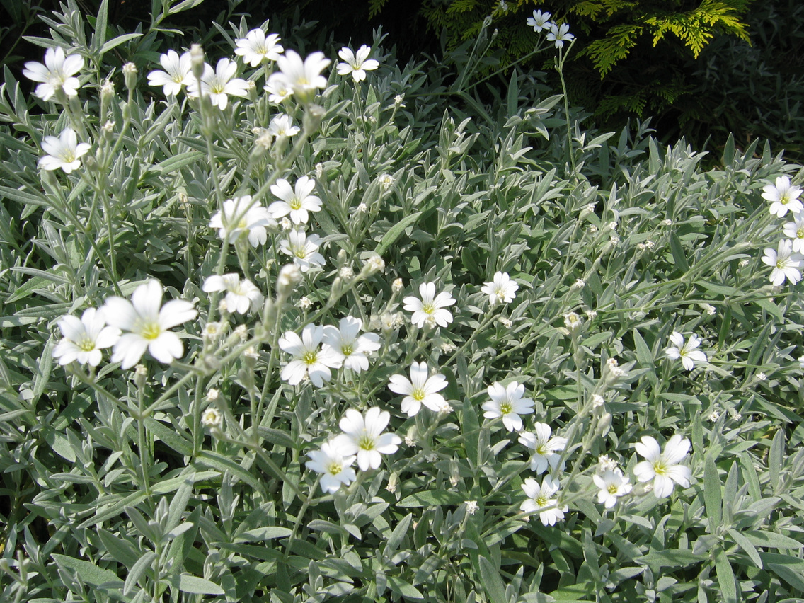
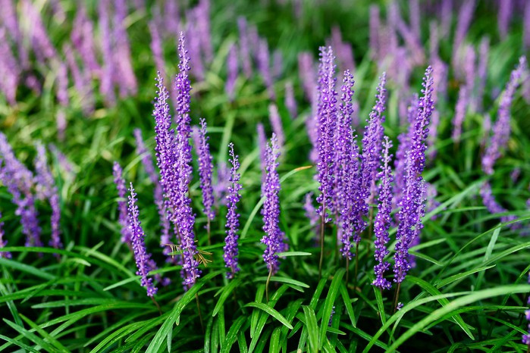
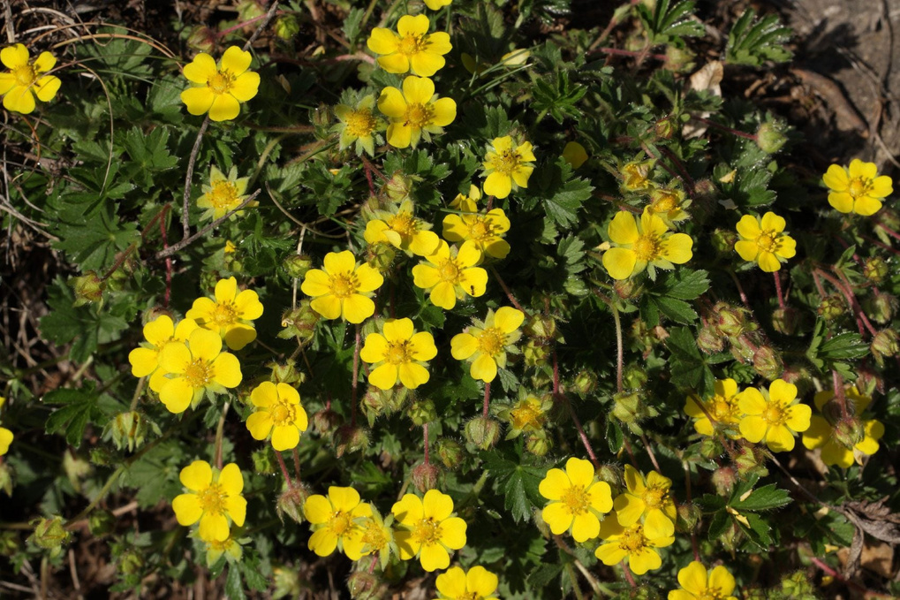
Examples
Snow-in-summer
(Certastium tomentosum)
lily-turf (Liriope spicatum)
Spring cinquefoil (Potentilla pusilla)
Notes:
Examples of low lying/producing less fuel plants
Snow-in-summer- not native. Typically only grows 4-6 inches tall keeping vegetation low to the ground. Does not act as a ladder fuel.
Lily-turf- not native. Grows compactly as a low-lying groundcover or as clumps. This means it produces less dry combustible litter, making it more fire resistant.
Spring Cinquefoil- not native. Grows in a low mat-forming style which produces low amounts of litter.
Photo Credit Lily-Turf: https://www.gardenersworld.com/how-to/grow-plants/how-to-grow-lily-turf/?srsltid=AfmBOoo_L6jnyOf95nFNe0L03hkIgBar6jKwURC6quKgwDzgh6fHBF_B

Slide 9
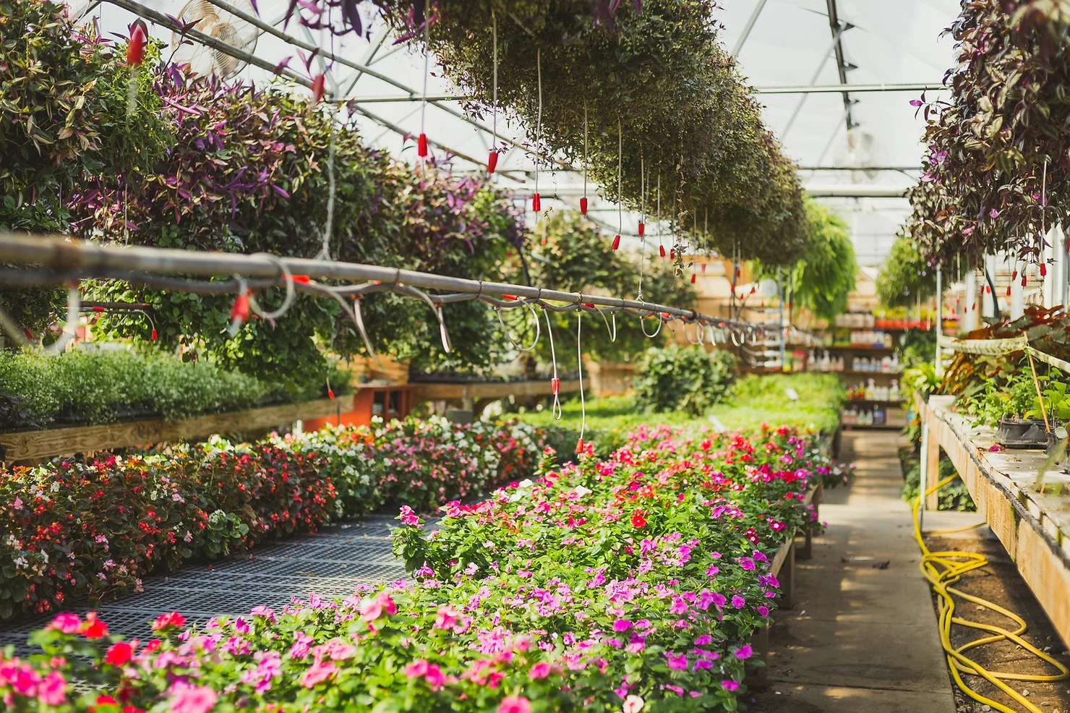
Where to find these plants
  Local nursery
  Buying seeds
  trusted online nurseries
Notes:
*Always do your own research or talk to a specialist about if a plant is Firewise.

Slide 10
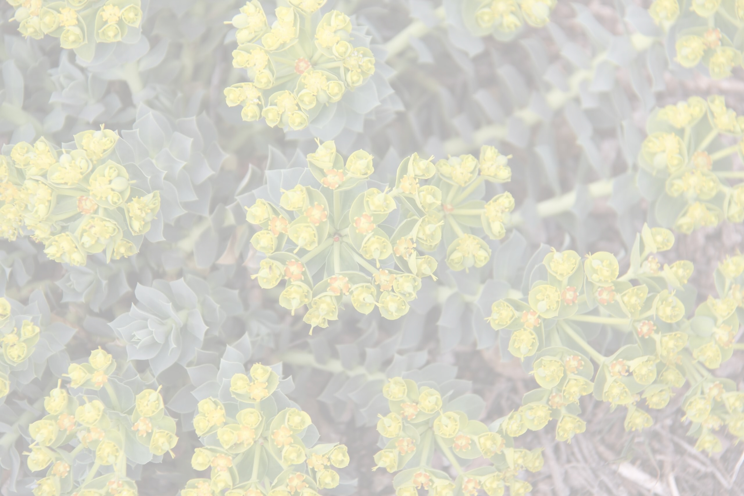
Never use noxious weeds!
Notes:
What is a noxious weed? They are a plant that is designated by federal, state or local government authorities as injurious to public health, agriculture, recreation, wildlife or property. These aggressive, often non-native plants can multiply quickly outcompeting native vegetation and threatening ecosystems and livestock.
*To find if a plant is noxious look at the State of Utah Noxious Weed List: (https://ag.utah.gov/plant-industry/noxious-weed/state-of-utah-noxious-weed-list/)
Pictured- Myrtle spurge

Slide 11
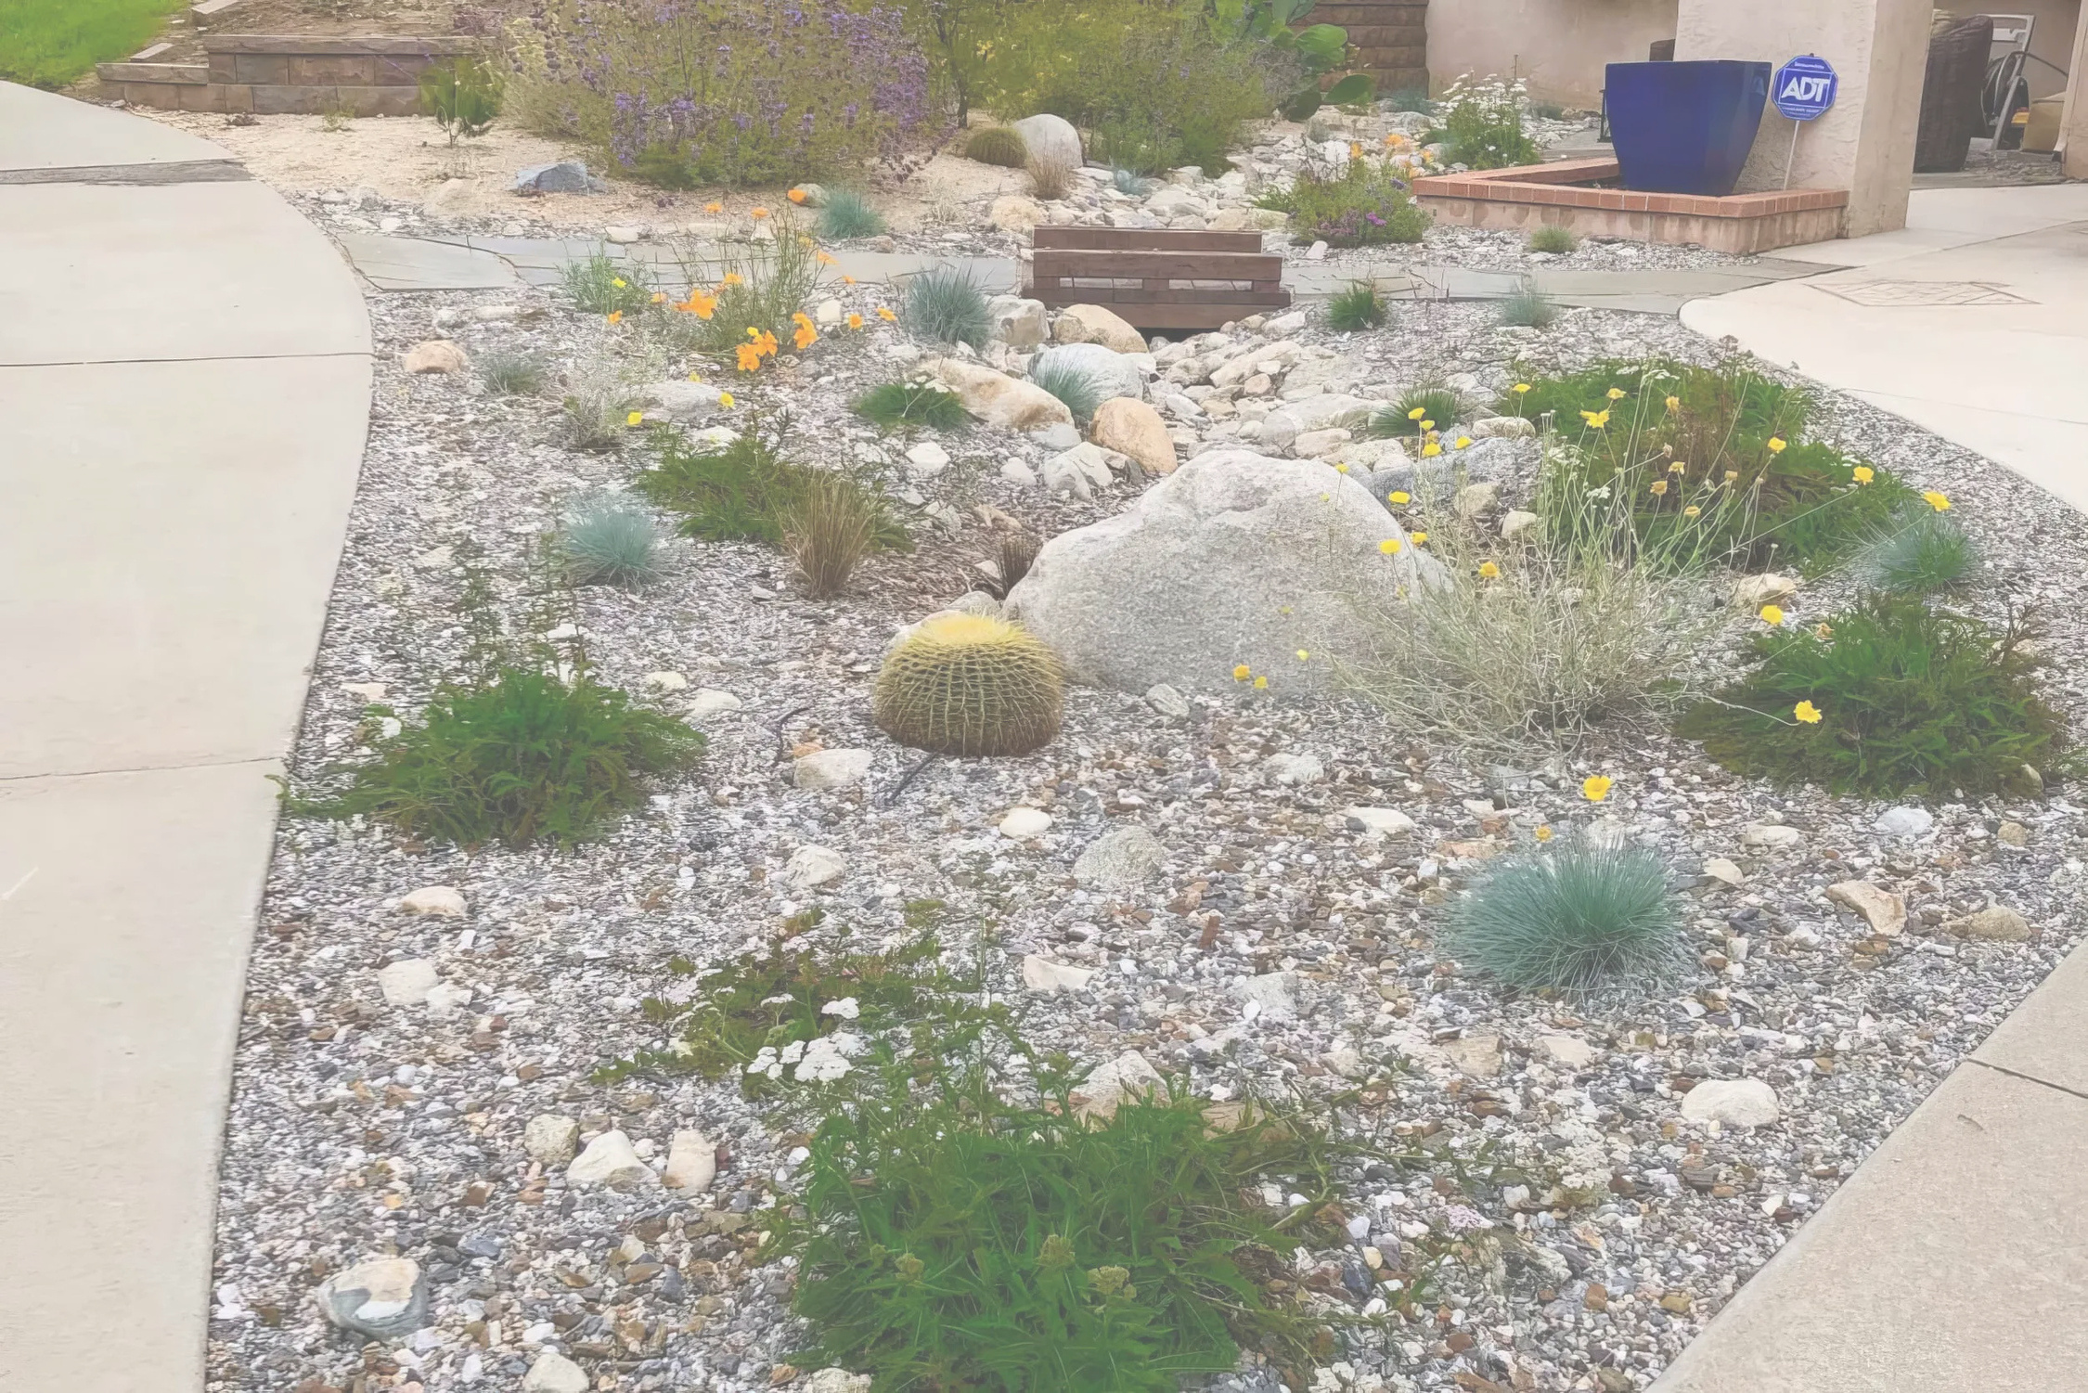
There are many plants that are not listed that could be considered Firewise, use the characteristics listed to guide you
Notes:
Photo Credit:https://firesafemarin.org/create-a-fire-smart-yard/firescaping/

